Slide 1
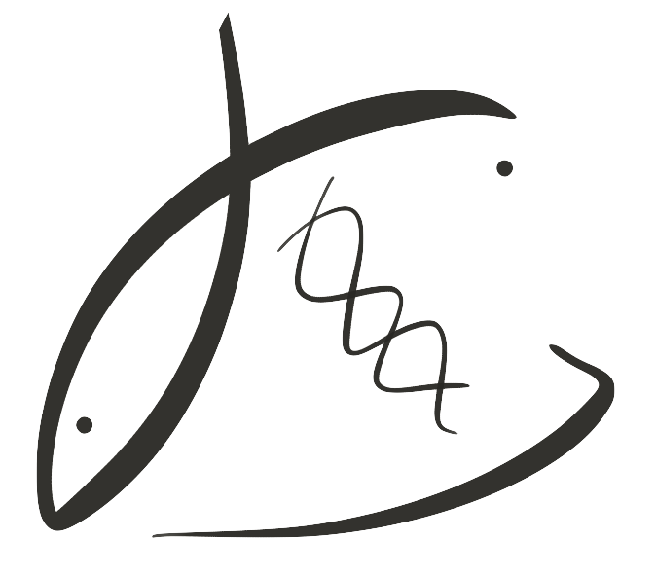





Effects of parental low pH exposure on gonadal and larval gene expression in the Olympia oyster
Laura H Spencer
Roberts Lab
School of Aquatic and Fishery Sciences
University of Washington
NSA Triennial, New Orleans 2019

Slide 2
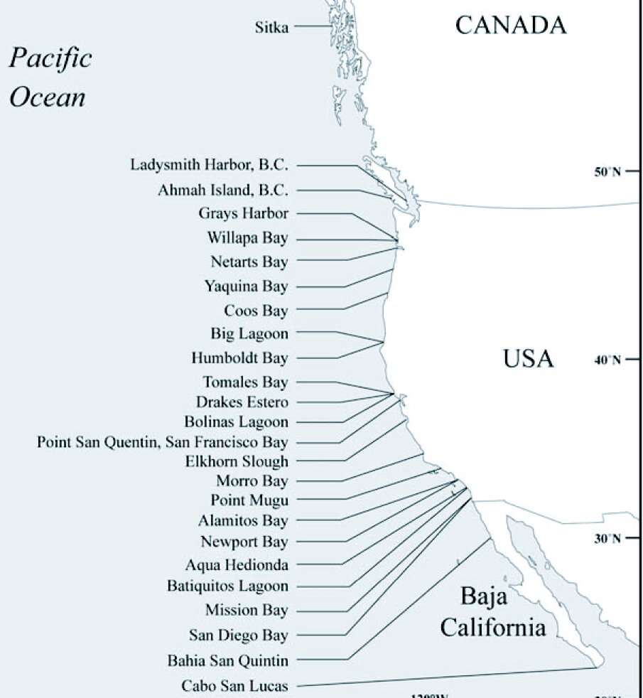
Ocean acidification, a new threat to the Olympia oyster
All Absent
Intertidal Absent
Adapted from Polson & Zacherl, 2009
Feely et al., 2008
Notes:
MAP: Augmented map of 2009 Olympia oyster survey that found some locations Olys are absent entirely or absent in the intertidal.

Slide 3
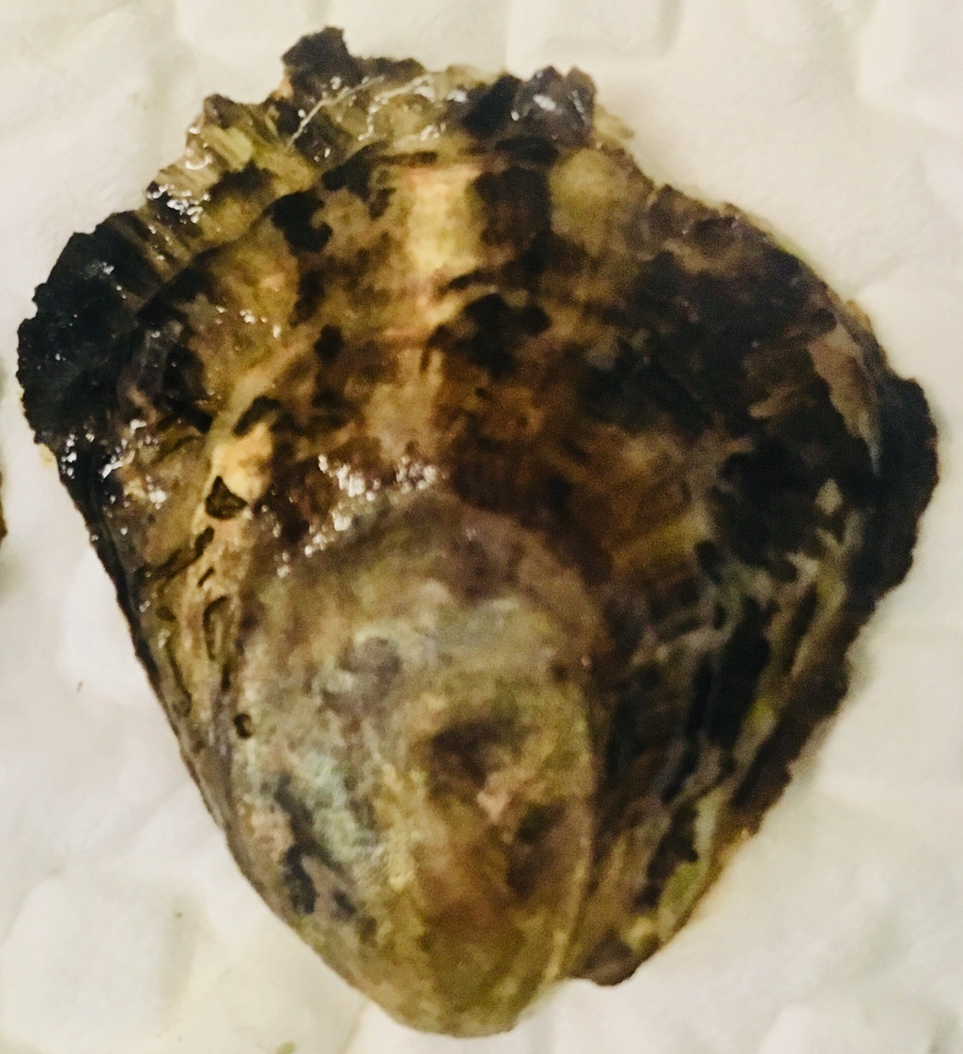
Can oysters “adapt” to OA?
Parental exposure can influence offspring response to stress (e.g. Parker et al. 2012)
This may allow oyster populations to quickly respond to changing ocean
Notes:
Early life stages are vulnerable
Reason why we’re interested in exploring adult exposure is that there is an exciting and optimistic theory that a parent’s exposure to stress can make the next generation more resilient to that stress.
This may allow for oysters to respond more quickly to ocean acidification, rather than relying solely on classic adaptation through gene mutation and natural selection.
(Paper: putnam 2016? Jeremias 2018? Rondon 2017?

Slide 4
Adult gonad First look at differential expression
RNA sequenced using QuantSeq
Up-regulated in low pH:
Biosynthesis (DNA, protein)
Transcription regulation
Protein transport & stabilization (HSP70, stress response?)
Down-regulated in low pH
Aerobic respiration
Cellulose digestion
Defense response to bacteria, fungus
Intracellular signaling
Translation, phospholipid biosynthesis
pH
PCA Biplot, normalized gene counts
Spawn & collect
Rear
Notes:
UP
Thymidylate synthase Nucleotide biosynthesis
H/ACA ribonucleoprotein complex subunit DKC1 Ribosome biogenesis, rRNA processing
Elongation factor 1-delta protein biosynthesis
C-terminal-binding protein Transcription regulation
HSP70 protein stabilization
DOWN:
Defense response:
Macrophage-expressed gene 1 protein host defense against bacteria
Hemagglutinin/amebocyte aggregation factor aggregation of amebocytes and agglutination of erythrocytes
Coactosin-like protein defense response to fungus
Biosynthesis / cell regulation:
Haloacid dehalogenase-like hydrolase domain-containing 5 glycerophospholipid biosynthetic process
Protein quaking-B cell differentiation, mRNA processing, regulation of translation, RNA splicing
Endoglucanase cellulose cellulose catabolic process
Rho guanine nucleotide exchange factor 3 intracellular signal transduction
S-crystallin SL11 S-crystallins are structural components of squids and octopi eye lens. Contains relatively little if any GST activity

Slide 5
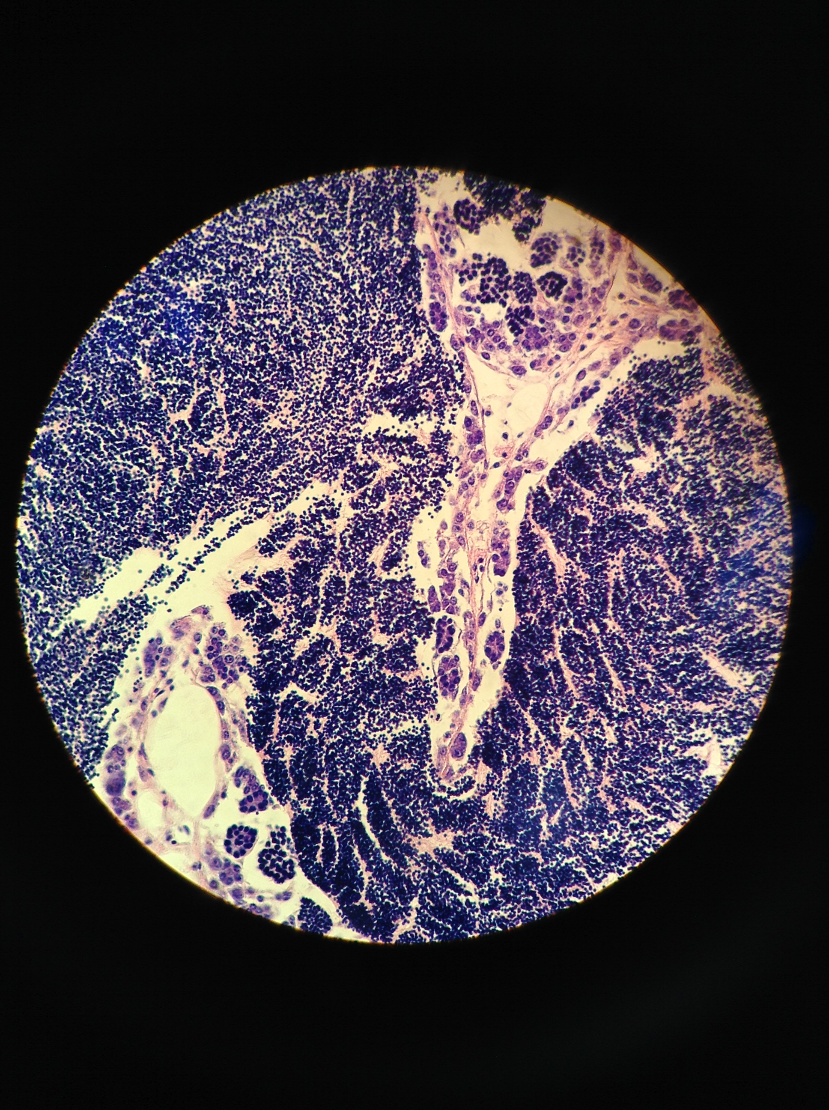
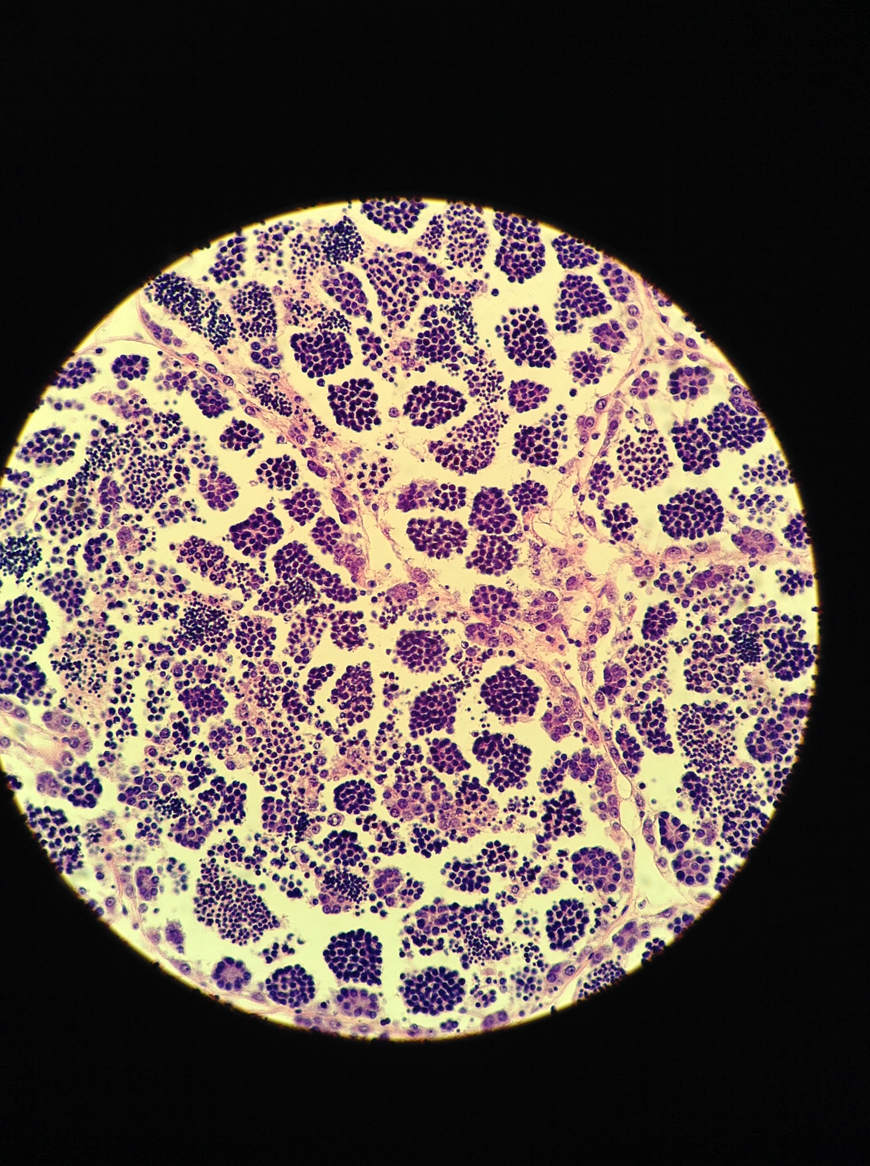
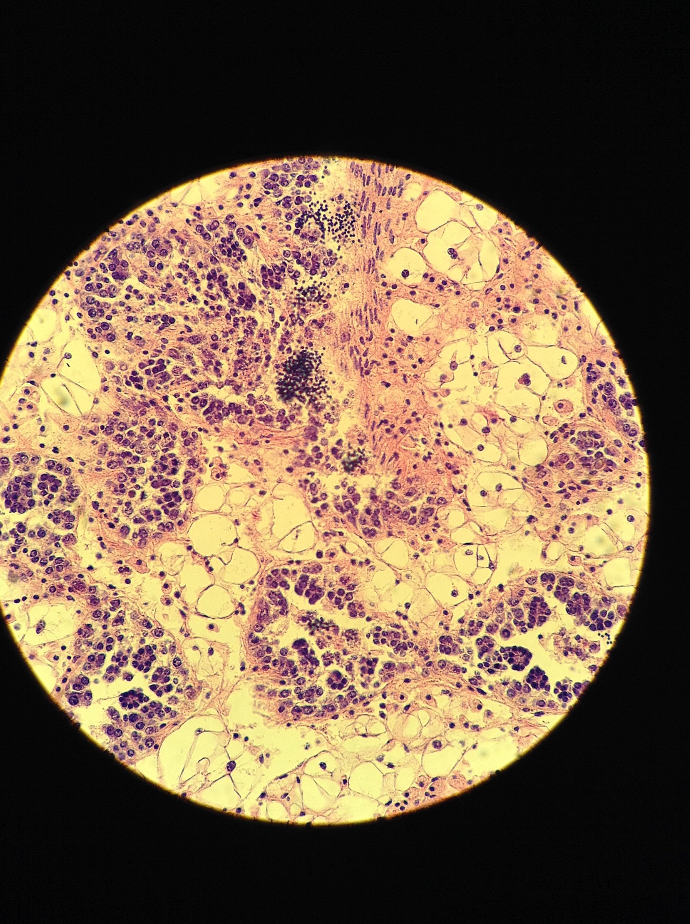
Delayed spermatogenesis, larval release No pH effect on fecundity
No Difference
STAGE 3
Ripe
May 17
June 1
No Difference
STAGE 2
Advanced
May 22
June 12
STAGE 1
Early

Slide 6
Newly released larvae
First look at gene expression
pH
RNA sequenced using QuantSeq
Up-regulated, low pH parents:
Cytoskeleton (Tubulin)
Cytoplasmic translation
Down-regulated, low pH parents
Aerobic respiration (COI)
Mitochondrial electron transport (mt:ND5)
DNA repair (ubiquitin component)
Protein transport, GTPase activity
PCA Biplot, normalized gene counts
Spawn & collect
Rear
Rear

Slide 7
Conclusions: Adults exposed to low pH
Adults
Delayed spermatogenesis & reproduction
⬇ Aerobic metabolism (COI)
⬆ Protein repair (HSP70)
No effect on sex ratios, fecundity
Offspring
Larval survival trended lower (not significant)
⬇ Aerobic metabolism, translation, protein transport (COI, mtND5, TBC1D2)
⬆ Cytoskeleton (Tubulin), DNA repair (rpl8)
Notes:
NOT NEGATIVE EFFECT SURVIVAL despite smaller size @ deployment

Slide 8
Who cares?
If parental pH exposure alters larval physiology …
Future generations more capable of surviving in low pH world?
Notes:
NOT NEGATIVE EFFECT SURVIVAL despite smaller size @ deployment

